Slide 1
Race Behind Bars
How the New York Times investigated racial disparity in the New York prison system
NICAR Jacksonville, March 4 2017
Robert Gebeloff | @gebeloffnyt |rgebeloff@nytimes.com

Slide 2
Race Behind Bars
Backstory: Rikers Island
.
NICAR Jacksonville, March 4 2017

Slide 3
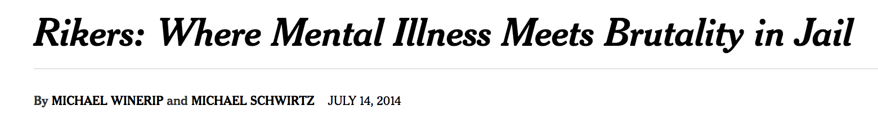
Race Behind Bars
Backstory: Rikers Island
.
NICAR Jacksonville, March 4 2017

Slide 4
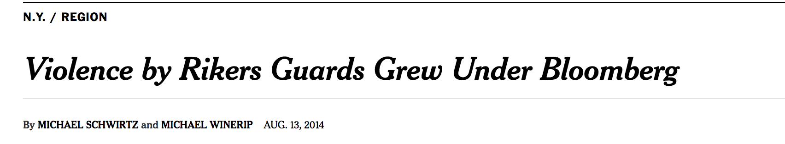
Race Behind Bars
Backstory: Rikers Island
.
NICAR Jacksonville, March 4 2017

Slide 5
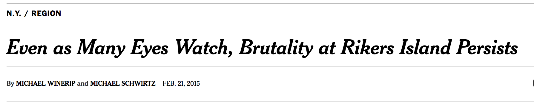
Race Behind Bars
Backstory: Rikers Island
.
NICAR Jacksonville, March 4 2017

Slide 6

Race Behind Bars
Backstory: Rikers Island
.
NICAR Jacksonville, March 4 2017

Slide 7
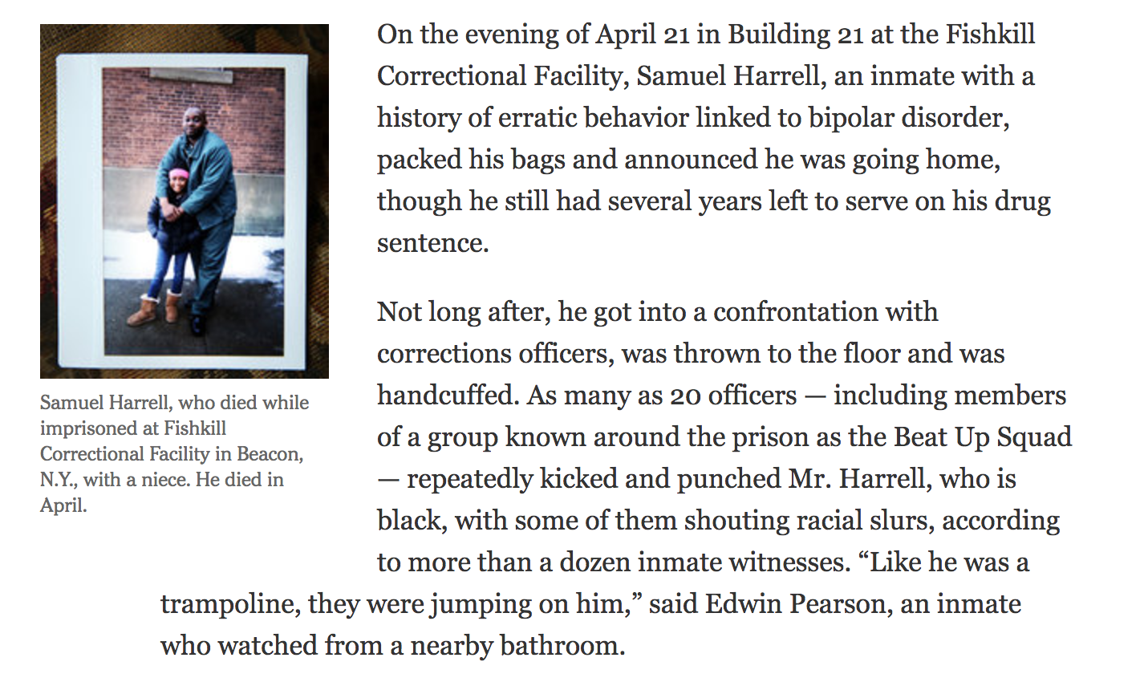
Race Behind Bars
.
NICAR Jacksonville, March 4 2017

Slide 8

Race Behind Bars
.
NICAR Jacksonville, March 4 2017

Slide 9
Race Behind Bars
In a security video obtained by The New York Times, Mr. Strickland is seen in handcuffs, barely conscious and being dragged along the floor by officers, while a prison nurse standing close by does nothing. Even as he lies face down on the floor, near death, guards can be heard shouting, “Stop resisting.”
NICAR Jacksonville, March 4 2017

Slide 10

Race Behind Bars
NICAR Jacksonville, March 4 2017

Slide 11
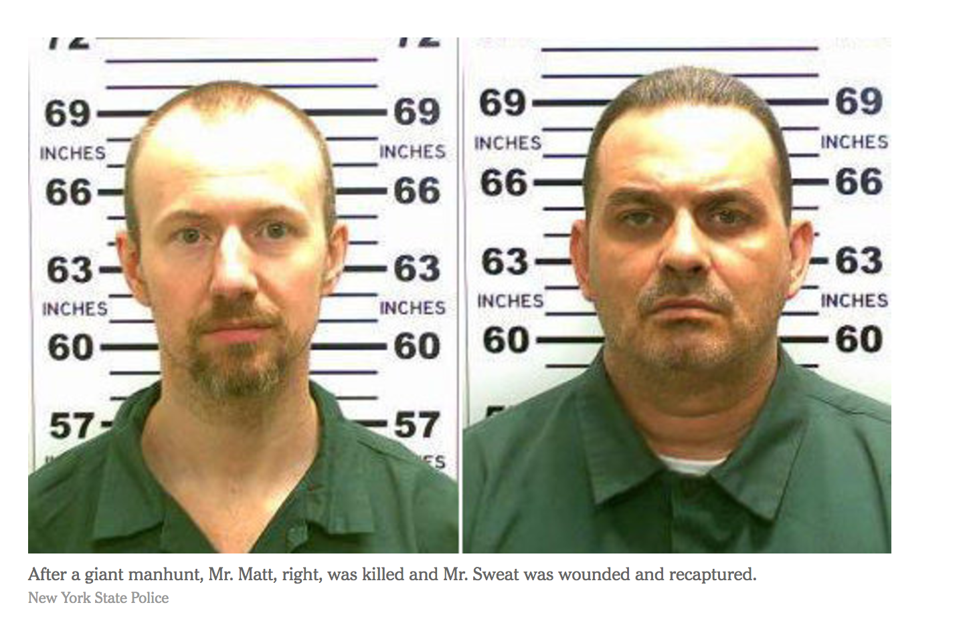
Race Behind Bars
.
NICAR Jacksonville, March 4 2017

Slide 12
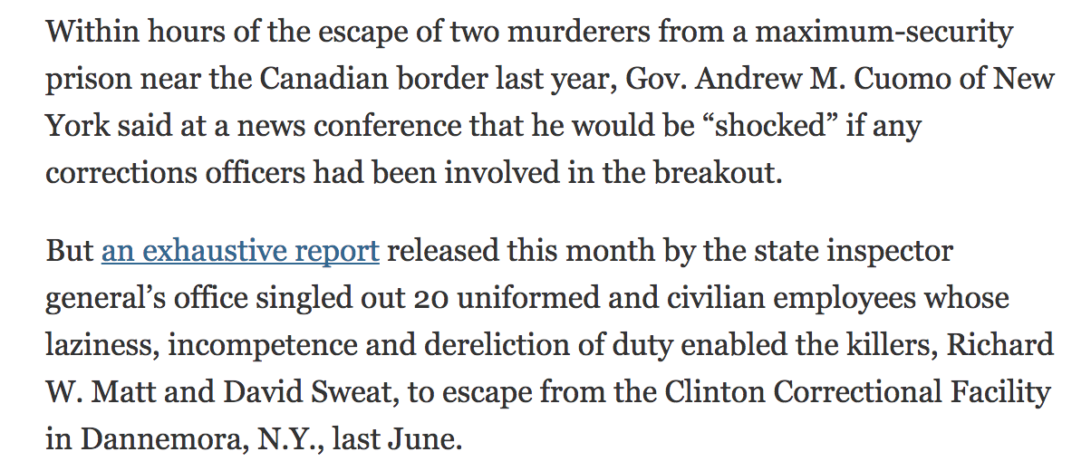
Race Behind Bars
.
NICAR Jacksonville, March 4 2017

Slide 13
Race Behind Bars
State officials dismissed the brutality stories as isolated incidents. Gov. Andrew Cuomo said officers needed to be physical with inmates to “get a certain amount of respect in the job, otherwise, they get hurt.”
.
NICAR Jacksonville, March 4 2017

Slide 14
Race Behind Bars
Thus began quest to analyze racial bias more methodically, using data…
.
NICAR Jacksonville, March 4 2017

Slide 15
Race Behind Bars
Data acquired:
-- Master roster of past and present inmates
.
NICAR Jacksonville, March 4 2017

Slide 16
Race Behind Bars
Data acquired:
-- Master roster of past and present inmates
-- Database of inmate disciplinary punishments for 2015
.
NICAR Jacksonville, March 4 2017

Slide 17
Race Behind Bars
Data acquired:
-- Master roster of past and present inmates
-- Database of inmate disciplinary punishments for 2015
-- Three years of parole board decisions
.
NICAR Jacksonville, March 4 2017

Slide 18
Race Behind Bars
Data acquired:
-- Master roster of past and present inmates
-- Database of inmate disciplinary punishments for 2015
-- Three years of parole board decisions
-- Paper reports on hundreds of “assault on staff” incidents
.
NICAR Jacksonville, March 4 2017

Slide 19
Race Behind Bars
Data acquired:
-- Master roster of past and present inmates
-- Database of inmate disciplinary punishments for 2015
-- Three years of parole board decisions
-- Paper reports on hundreds of “assault on staff” incidents
-- Transcripts of more than 100 parole board hearings.
.
NICAR Jacksonville, March 4 2017

Slide 20
Race Behind Bars
Analytical approach:
Individual datasets good.
Joined datasets better.
.
NICAR Jacksonville, March 4 2017

Slide 21
Race Behind Bars
Analytical approach:
The disciplinary data did not contain any demographic characteristics of inmates. But we were able to join this data to the master roster of inmates, which included race, age, severity of the crime of conviction, etc.
.
NICAR Jacksonville, March 4 2017

Slide 22
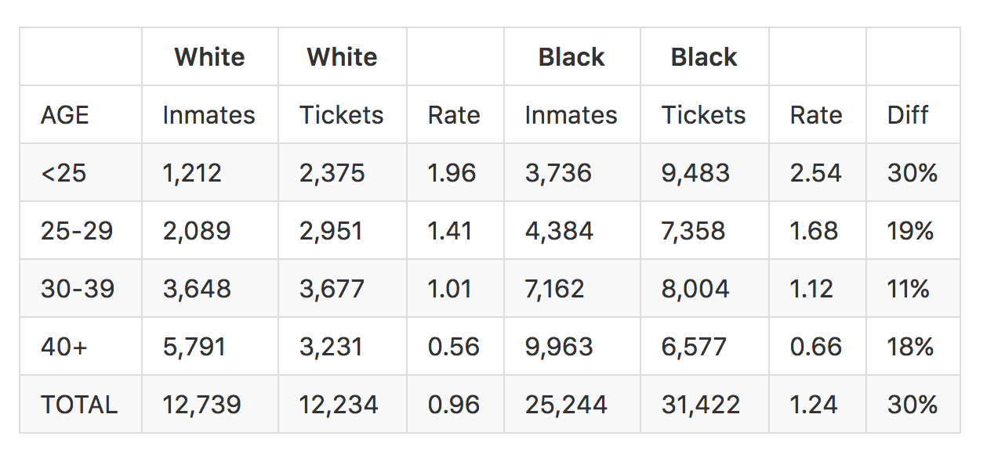
Race Behind Bars
.
NICAR Jacksonville, March 4 2017

Slide 23
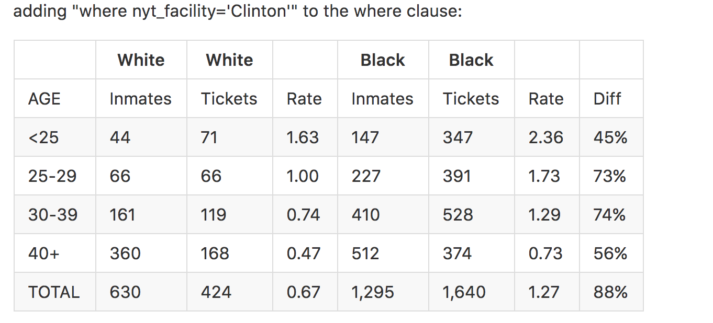
Race Behind Bars
.
NICAR Jacksonville, March 4 2017

Slide 24
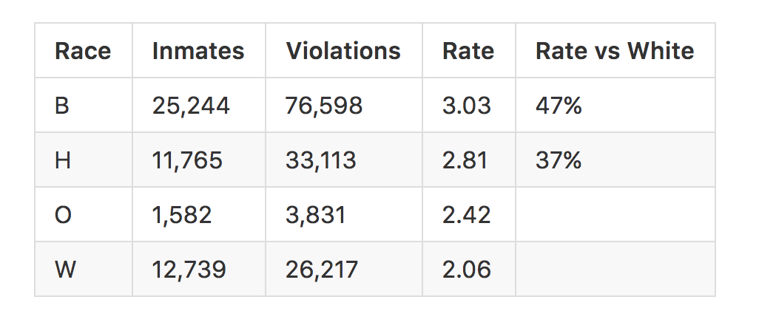
Race Behind Bars
.
NICAR Jacksonville, March 4 2017

Slide 25
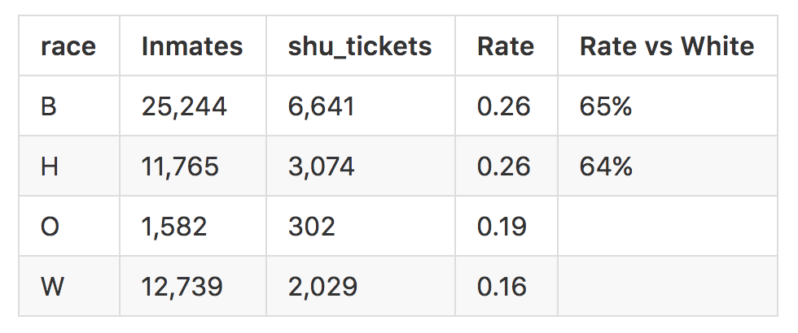
Race Behind Bars
.
NICAR Jacksonville, March 4 2017

Slide 26
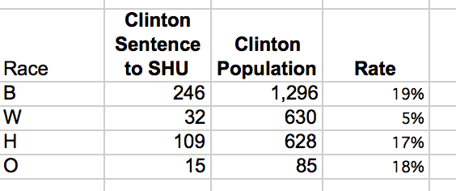
This table shows the racial distribution of inmates sentenced to solitary confinement at the Clinton Correctional Facility in 2015, compared to the overall inmate population.
NICAR Jacksonville, March 4 2017

Slide 27
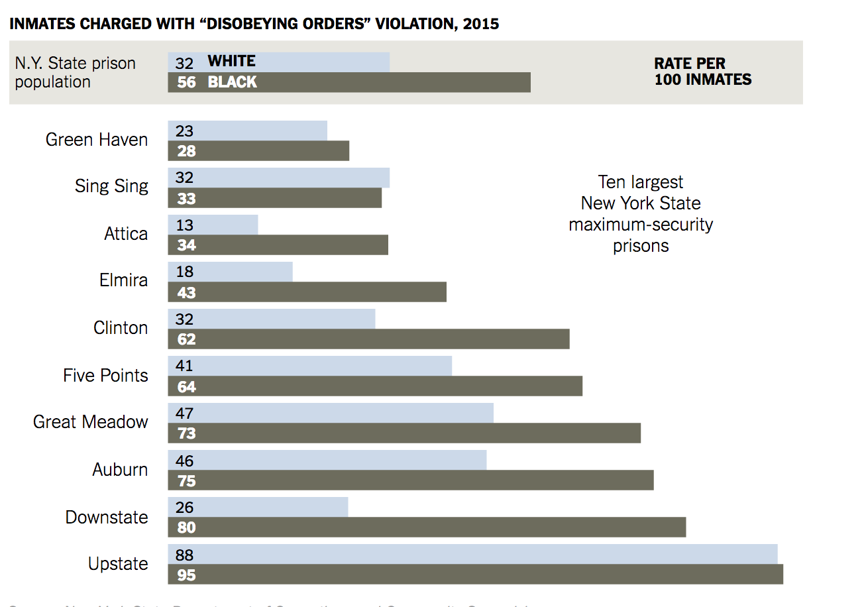
Race Behind Bars
.
NICAR Jacksonville, March 4 2017

Slide 28
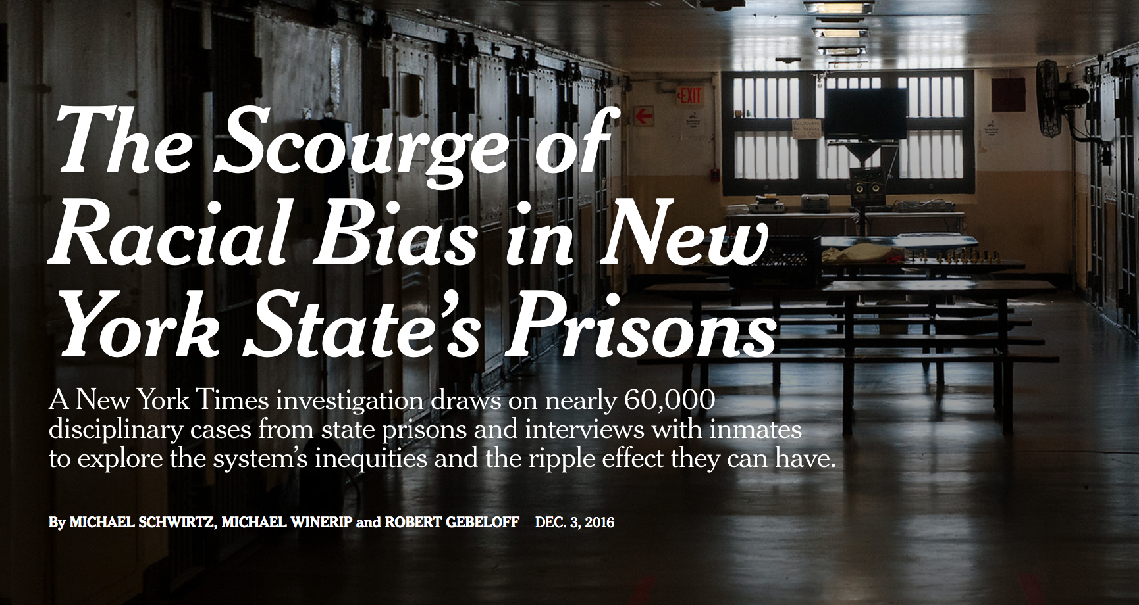
Diversity, Segregation and Disparity
https://nyti.ms/2jDMoMz
NICAR Jacksonville, March 4 2017

Slide 29
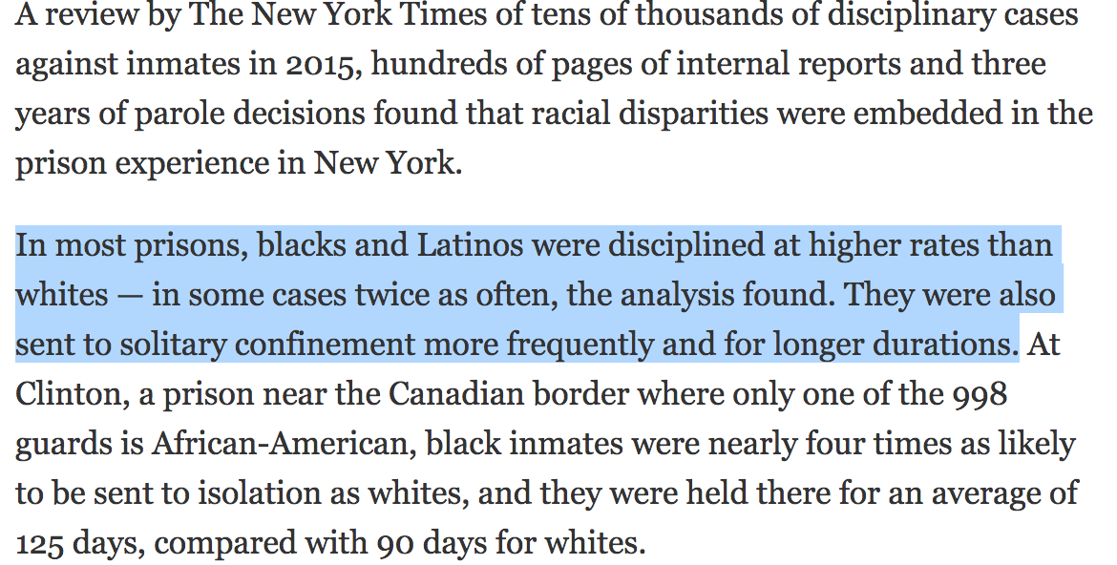
DISPARITY: WHAT IS IT AND HOW DO YOU MEASURE IT?
NICAR Jacksonville, March 4 2017

Slide 30
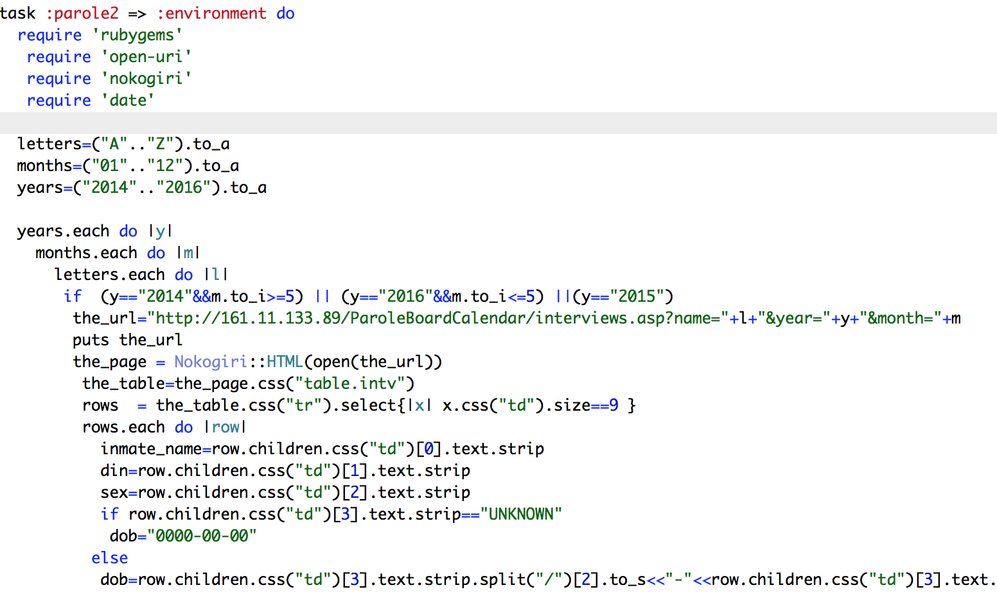
Diversity, Segregation and Disparity
NICAR Jacksonville, March 4 2017

Slide 31
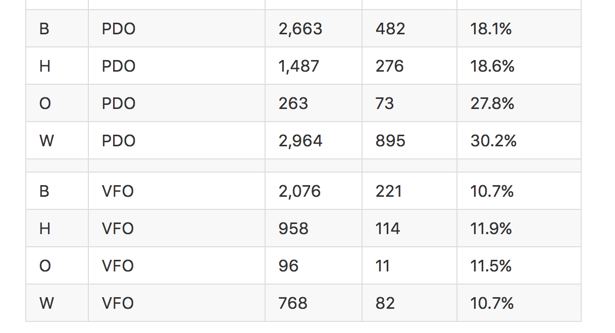
NICAR Jacksonville, March 4 2017

Slide 32
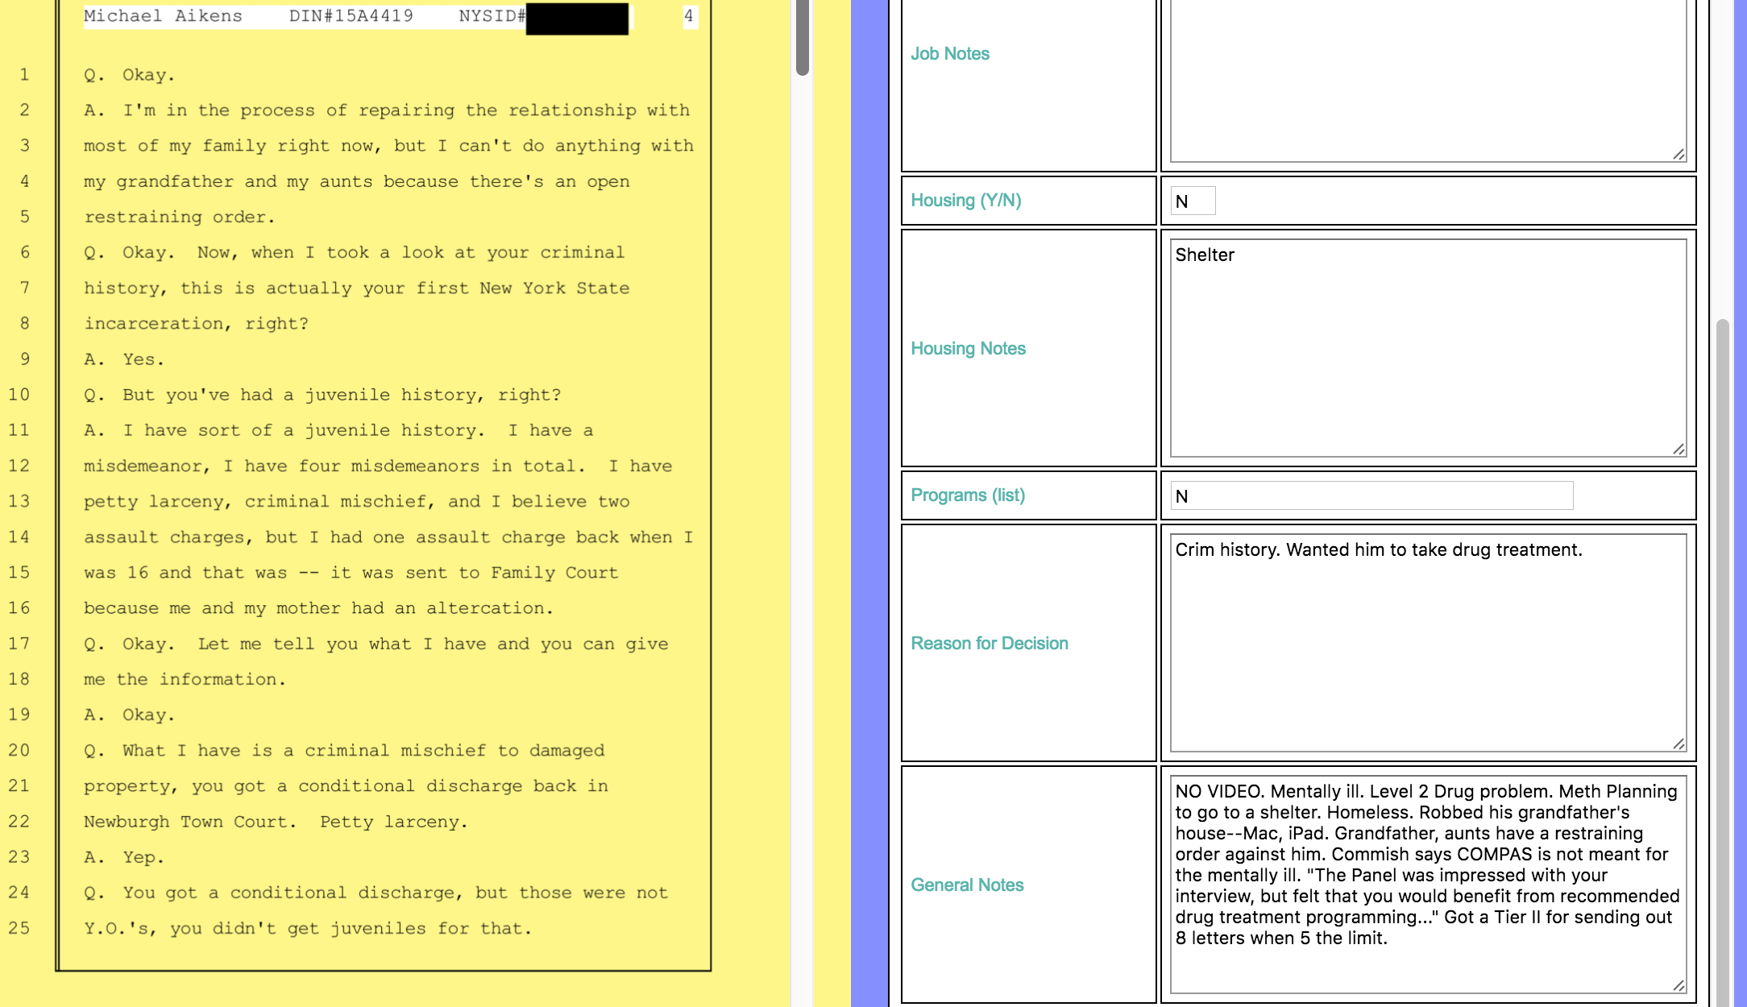
NICAR Jacksonville, March 4 2017

Slide 33
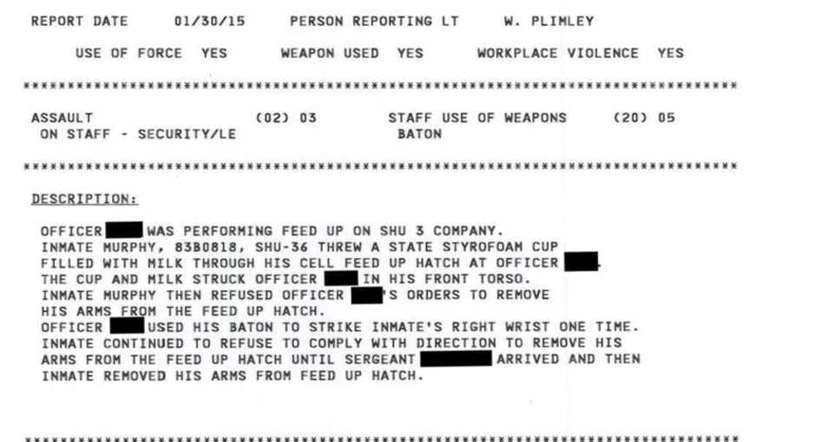
NICAR Jacksonville, March 4 2017

Slide 34
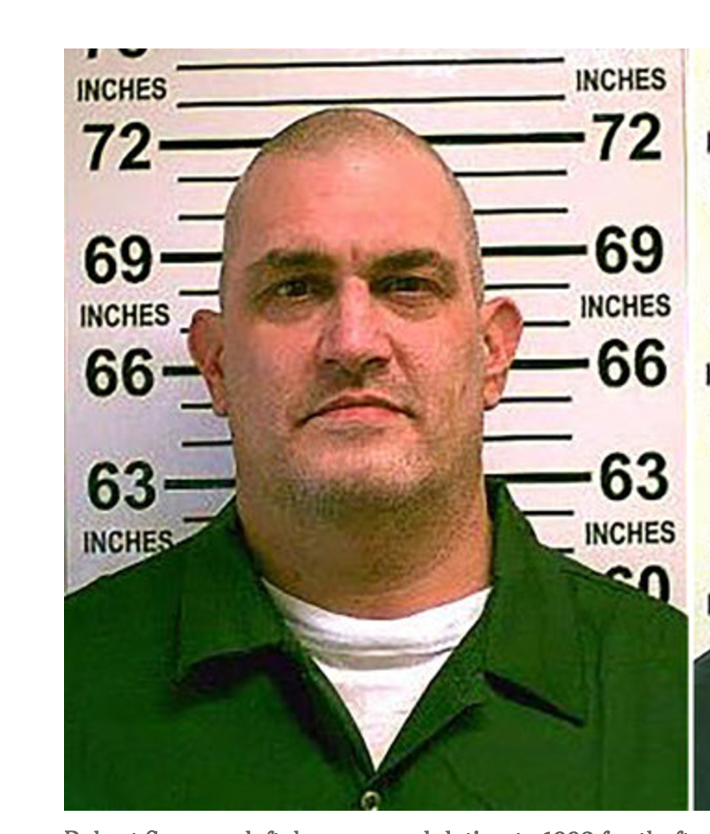
NICAR Jacksonville, March 4 2017

Slide 35
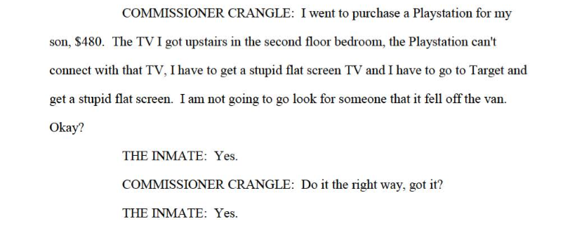
NICAR Jacksonville, March 4 2017

Slide 36
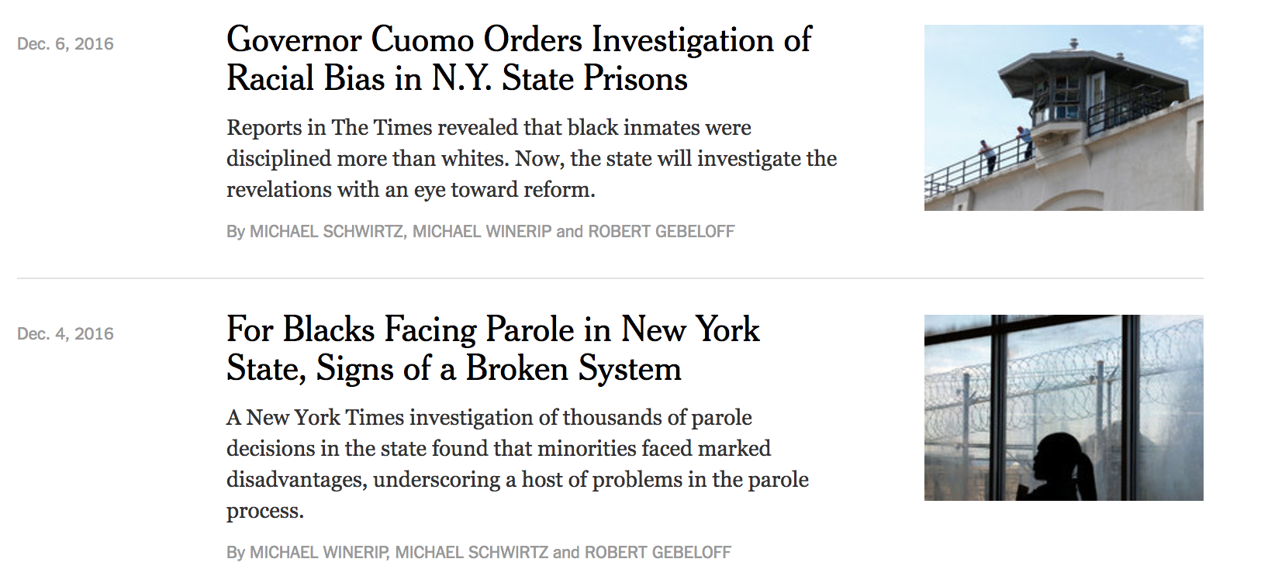
NICAR Jacksonville, March 4 2017

Slide 37
LINKS:
All of the stories in this series are on my New York Times page:
https://www.nytimes.com/by/robert-gebeloff
This presentation and other training material are on my Github page:
https://github.com/gebelo
A more detailed presentation on how to statistically measure and quantify disparty is here:
https://github.com/gebelo/training2017/blob/master/irewatchdog2017.pptx
NICAR Jacksonville, March 4 2017

